Slide 1
Digital Literacy 5
Internet Operation
IP addressing and DNS

Slide 2
IP addresses and DNS
How are resources identified and found on the internet?
What is the relationship between the human-readable names we see in addresses for resources (eg. URLs or Email addresses), and numeric IP addresses?
Notes:
User perspective : access to huge number of services and communication systems (netflix, email, websites, telephony)

Slide 3
The hosts file
In the old days, each internet user had a file on their own computer with a list of all the names and numbers on the internet. Every day, a new one was published.
You can still look at your hosts file today (and sometimes even use it to connect to a resource you can’t find another day)

Slide 4
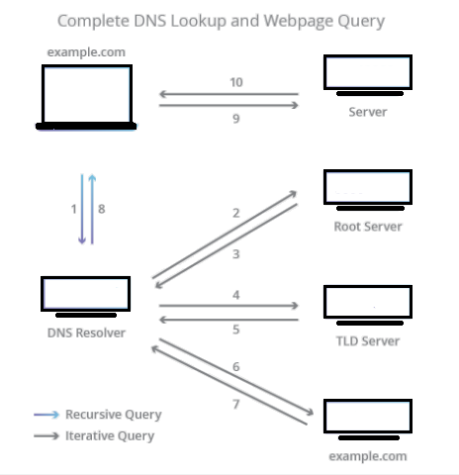
DNS: A distributed database matching names and numbers

Slide 5

Query a name and IP addresses
The ‘host’ command queries your DNS resolver to map names to numbers

Slide 6
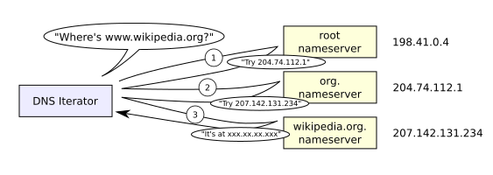
DNS name resolution
By Lion Kimbro - Own work, Public Domain, https://commons.wikimedia.org/w/index.php?curid=386517
Notes:
In this simplified example, we see the hierarchical method by which records about names and numbers are held.
The ‘root’ nameservers hold information about all domain names ending in .org
The .org nameserver holds records about which nameservers are valid for all wikipedia domains
The wikipedia nameserver holds records about all wikipedia domains (including subdomains such as www.wikipedia.org, mail.wikipedia.org and any others)
The wikipedia.org nameserver holds a configuration file called a zone file which has records of all the subdomains for wikipedia (in this case..) or whatever
When you ‘buy’ a domain name, you will have to specify the nameserver for the domain (often but not always the DNS vendor), and provide information on the location of the servers which actually host your content. The mappings in yoru domain are entered into a ‘zone file’ which sits on your DNS server.
In reality, there are many layers of caching (ie. holding temporary, frequently used records) on all levels, but the general hierarchical principle holds.

Slide 7
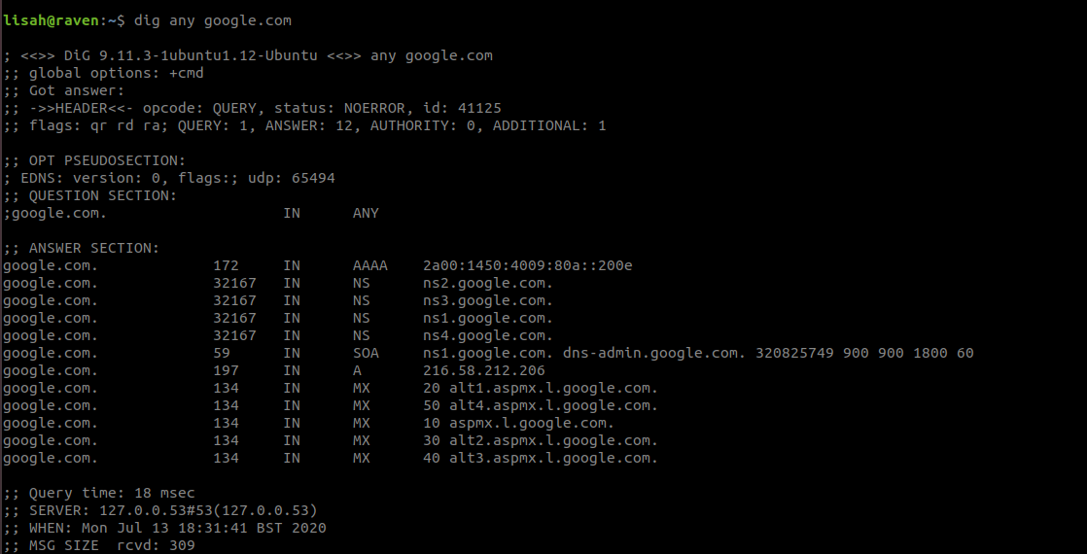
Find out DNS information
The ‘dig’ command reveals information about nameservers
and servers providing services for a domain

